Slide 1
drinkpoppi
Instagram Profile Analysis Presentation
2026-02-11
Notes:
title_page

Slide 2
How to use this deck
This deck is your secret marketing intelligence tool and superpower. It’s your shortcut to finding the macro and micro nuggets of information and inspiration you need to craft killer strategy.
By scouring this Instagram profile, we’ve tracked the conversations and content that matter. All of it has then been distilled to this presentation, so you know what matters to this audience.
So use it to get inspired. Use it to learn. Use it to know more about this brand than your competition. But however you use it, use it wisely.
Enjoy!
❤️ Autostrat Team
Notes:
how_to_use

Slide 3
Audience Profile
This audience embodies youthful cultural vibrancy, drawn to exclusive drops and authentic influencers. They demand reliable product availability and clear brand communication, while actively seeking community expression via merch and shared 'vibes'. Navigating their passionate but exacting engagement requires transparency and immersive, value-rich experiences.
NEEDS
Clear, consistent product availability to avoid frustration and confusion. | Seamless digital purchase experiences to capitalize on hype moments. | High-touch, culturally relevant influencer collaborations that spark active community participation.
OBJECTIONS
Frustration and distrust due to inconsistent product availability and unclear communication. | Skepticism about health claims and genuine product benefits. | Resistance to packaging redesign perceived as losing brand personality.
DESIRES
To belong to a vibrant, youthful community defined by shared cultural 'vibes'. | To experience exciting, exclusive product drops that create urgency and community buzz. | To engage with relatable, authentic influencers who reflect their cultural values.
PAIN POINTS
Difficulty finding favorite flavors in stores, leading to consumer frustration and distrust. | Confusing or disliked product packaging redesign sparks negative brand sentiment. | Skepticism regarding health benefit claims and ingredient authenticity.
Notes:
audience_analysis

Slide 4
To win, brands must fuse culture, exclusivity, and flawless product access into rhythmic storytelling that fuels anticipation and community ownership.
How to Win With This Audience
Territory 1
Embed your brand into authentic cultural moments that ignite community identity and passion.
Territory 2
Leverage scarcity and exclusive influencer collaborations to build hype rhythms that drive anticipation.
Audience Verbatims
Territory 3
Ensure product availability aligns precisely with social buzz to convert engagement into loyalty.
Where can u actually get these bc it seems like no where
Can we please stock Shirley before we worry about a new flavor? 😭
Hi poppi, I don’t know if this is an error but how it’s the robe and the charger cord sold out on the Tyb shop if you just post it? @tyb.xyz @drinkpoppi
need me some poppi stickers to decorate my laptop 💻 needs a POP of color
Yaaassss I need a whole keg of Poppi too
Territory 4
Activate tangible brand touchpoints like merch to transform passive consumers into active evangelists.
Territory 5
Adopt rhythmic, event-driven content cadence turning posts into must-see cultural happenings.
Notes:
how_to_win

Slide 5
Future Sponsorship Suggestions
Poppi blends lifestyle, influencer partnerships, and product scarcity to build a loyal cultural community. Addressing product availability and communication gaps is vital. Jose Cuervo should emulate this immersive vibe-driven storytelling to engage younger, culture-focused audiences.
Health and Wellness Brands
Music and Entertainment
Fashion and Lifestyle Apparel
E-Commerce Infrastructure & Tech
Shared commitment to authentic health appeals to wellness-seeking Gen Z consumers. | Music partnerships fuel Poppi’s cultural vibe and audience passion. | Merchandise channels brand love into visible, participatory culture. | Smooth online shopping underpins conversion from buzz to revenue.
Why it Works | Why it Works | Why it Works | Why it Works
Poppi’s health-conscious soda audience craves genuine functional benefits and natural ingredients, making alignment with trusted wellness brands a natural extension. | Poppi’s authentic collaborations with cultural icons like Charli XCX catalyze massive engagement; extending partnerships to entertainment brands would deepen cultural embedment. | The audience’s active desire for merchandise and tangible brand expression opens a door for fashion brands to deepen emotional connection and identity expression. | Audiences repeatedly experience friction with online ordering and sold-out notifications, highlighting necessity for frictionless digital commerce platforms to convert excitement into sales.
How to Activate | How to Activate | How to Activate | How to Activate
Co-create content highlighting genuine gut health benefits with wellness experts. Produce lifestyle videos blending fitness and beverage rituals emphasizing natural ingredients. Host experiential activations tying Poppi consumption to holistic self-care routines. | Launch limited edition flavors tied to music festivals or artist tours. Feature behind-the-scenes artist content with branded experiential giveaways. Co-develop exclusive pop-up events combining beverage tasting and live performances. | Collab on limited-run apparel tied to exclusive flavor drops. Design merch drop campaigns that integrate digital community challenges. Use apparel as identity badges in live and digital events. | Integrate real-time inventory updates synced with marketing campaigns. Offer early-access online drops through platform gamification. Leverage mobile-friendly checkout flows optimized for high traffic spikes.
Notes:
future_sponsorships

Slide 6
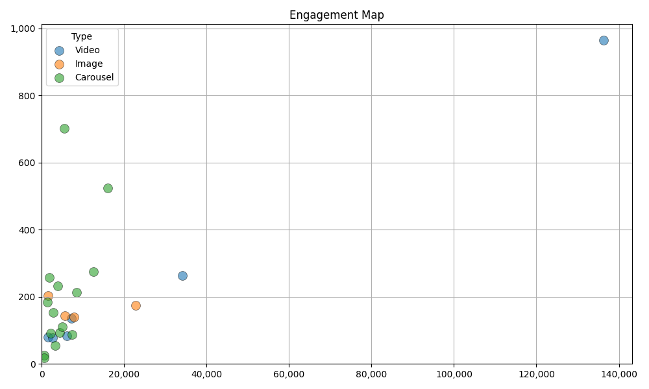
Engagement Analysis
Summary
Poppi’s audience thrives on authentic connections, exploding on posts integrating influencers, giveaways, and cultural moments.
Top videos yield likes in six figures with comments surpassing 900+ (e.g., 136K likes/964 comments).
Conversely, product-only posts without cultural context or engagement CTAs garner middling response.
The tone-driven comment culture—fans echoing 'VIBES' en masse—creates a self-reinforcing community, showing Poppi’s success hinges on participatory brand ethos and live social momentum.
Notes:
engagement_analysis

Slide 7
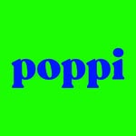
Snapshot
We’ve scoured this profile to understand how this account speaks to their audience while uncovering the real conversations, emotions, wants and needs happening in the comments.
drinkpoppi
Followers
Following
635,290
2,832
Avg Likes
Avg Comments
Avg Engagement Rate
12,062
211
1.93 %
All performance and averages are based on last 50 uploads
Engagement rate calculated as comments and likes over followers
Notes:
creator_snapshot

Slide 8
Creator Summary
Search Purpose
Study Poppi's Instagram as a fellow beverage brand with strong Gen-Z appeal. How do they balance product shots, lifestyle, and cultural content? What's their engagement strategy? and what can a Jose Cuervo use from their strategy to incorporate into their own
Topline
Common Themes and Topics
'VIBES' as a unifying cultural theme—Poppi frames every post, caption, and collab through a playful, youthful vibe-centric lens, creating lifestyle identity.
Poppi’s Instagram is a masterclass in vibe-driven branding, merging colorful product showcases with cultural collaborations and lifestyle content.
Their vibrant, playful persona connects deeply with Gen Z and Millennials, fueling high engagement through authentic, music-centered narratives and event-based activations.
What Hits
Music-centered videos, giveaways, and limited-edition collaborations drive the highest engagement and conversation, signaling strong community alignment and excitement.
What it Means for You
Poppi turns product into culture by using authentic influencer partnerships and mood-driven narratives, creating deep community engagement.
Jose Cuervo can learn to embed their brand within social vibes and cultural moments to resonate with Gen Z.
What Misses
Rebranding efforts without clear product availability alienate fans; ambiguous posts without strong brand or cultural anchors underperform.
Notes:
creator_summary

Slide 9
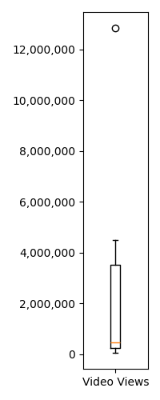
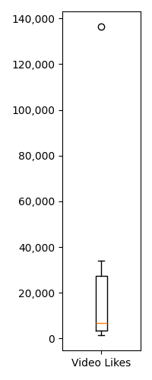
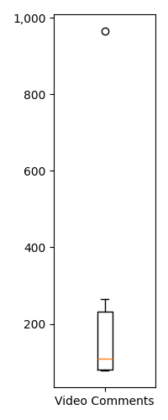
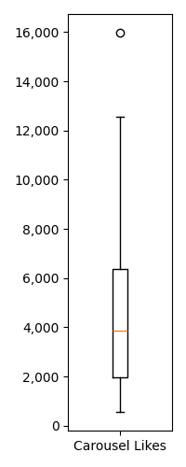
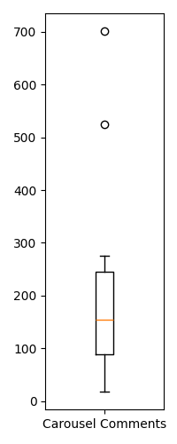
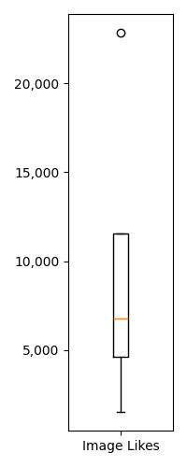
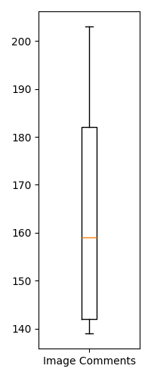
Summary Statistics - By Post Type
Videos
Carousels
Images
Video Post Count: 6
Carousel Post Count: 15
Images Post Count: 4
Min Views | 48,964
Max Views | 12,830,063
Median Views | 461,941
Avg Views | 3,079,673
Min Likes | 1,473
Max Likes | 136,347
Median Likes | 6,636
Avg Likes | 31,328
Min Comments | 78
Max Comments | 964
Median Comments | 109
Avg Comments | 267
Min Likes | 562
Max Likes | 15,970
Median Likes | 3,853
Avg Likes | 5,049
Min Comments | 18
Max Comments | 701
Median Comments | 154
Avg Comments | 201
Min Likes | 1,522
Max Likes | 22,837
Median Likes | 6,749
Avg Likes | 9,464
Min Comments | 139
Max Comments | 203
Median Comments | 159
Avg Comments | 165
Notes:
post_summary_statistics

Slide 10
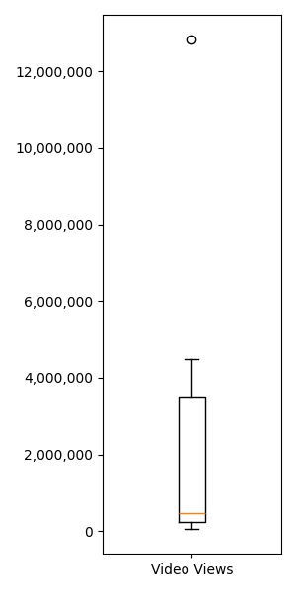
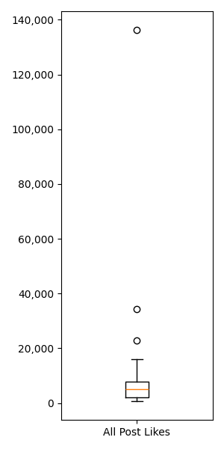
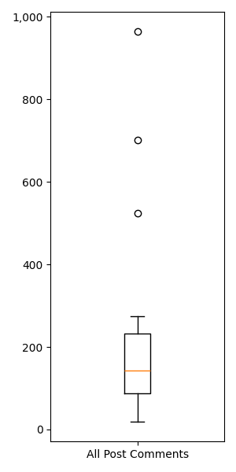
Summary Statistics - All Posts
Views
Likes
Comments
Min Views | 48,964
Max Views | 12,830,063
Median Views | 461,941
Avg Views | 3,079,673
Min Likes | 562
Max Likes | 136,347
Median Likes | 5,017
Avg Likes | 12,062
Min Comments | 18
Max Comments | 964
Median Comments | 143
Avg Comments | 211
Notes:
all_summary_statistics

Slide 11
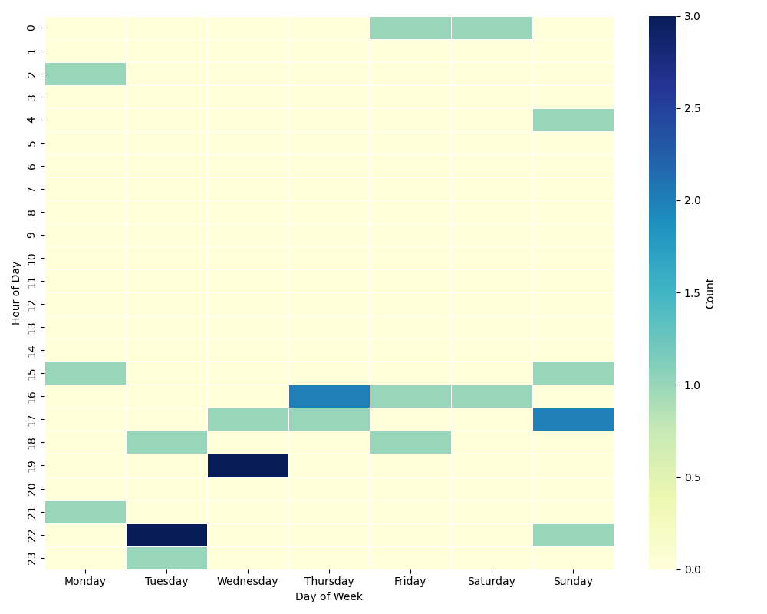
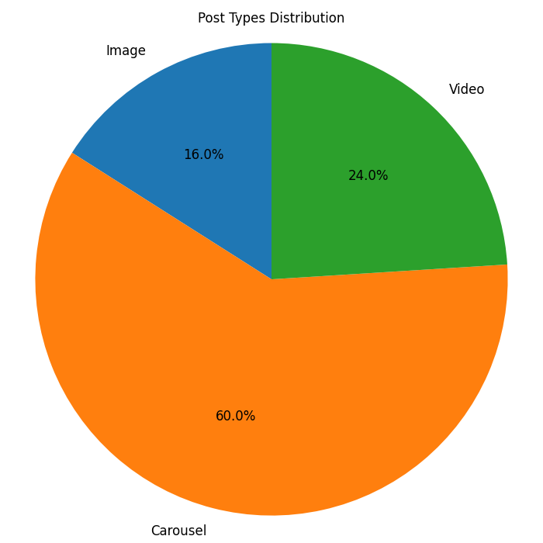
Posting Analysis
Summary
Posting Heatmap
Post Mix
Poppi posts frequently—balancing videos, carousels, and images—but cadence is less about volume and more about timing relative to product drops, cultural moments, and influencer events.
Their strategy appears rhythmic yet opportunistic, releasing high-impact video content around events like the Super Bowl or film premieres and sprinkling engaging lifestyle posts to sustain vibe culture.
This rhythmic yet flexible timing sustains momentum and community anticipation, making each post a must-see event rather than filler.
Notes:
posting_analysis

Slide 12
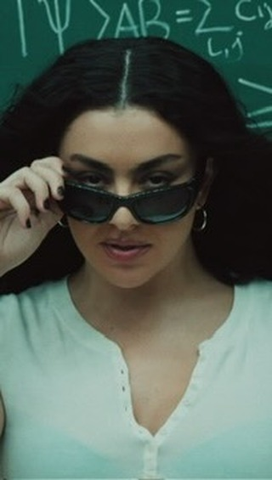
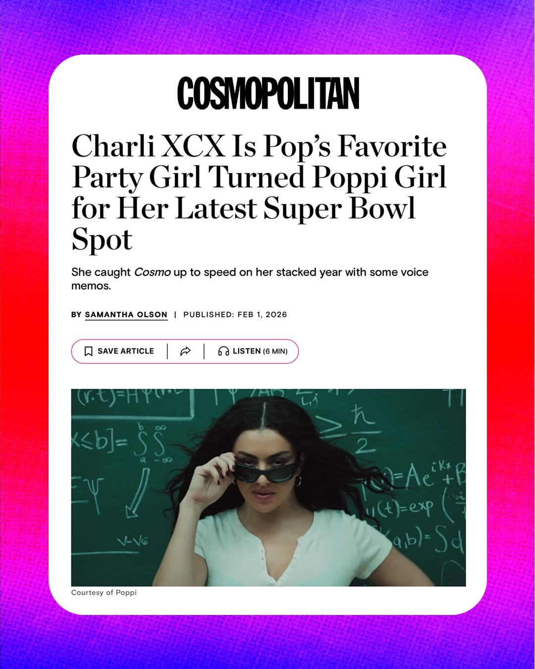
Most / Least Liked
Most Liked
Least Liked
Caption | vibes? vibes…vibes! (vibes) @drinkpoppi #poppipartner
Engagement Rate | 21.61 %
Likes Count | 136,347
Comment Count | 964
Link | https://instagram.com/p/DUhQms6jI1W/
Caption | what, was there a game sunday? we were busy vibing with charli and rachel 🤭 did you catch us at the game? let us know your fave part in the comments 👀
Engagement Rate | 0.09 %
Likes Count | 562
Comment Count | 18
Link | https://instagram.com/p/DUln589j1kt/
All performance and averages are based on last 50 uploads
Engagement rate calculated as comments and likes over followers
Note statistics may be skewed due to recency bias
Notes:
most_liked

Slide 13
Most / Least Comments
Most Comments
Least Comments
Caption | vibes? vibes…vibes! (vibes) @drinkpoppi #poppipartner
Engagement Rate | 21.61 %
Likes Count | 136,347
Comment Count | 964
Link | https://instagram.com/p/DUhQms6jI1W/
Caption | what, was there a game sunday? we were busy vibing with charli and rachel 🤭 did you catch us at the game? let us know your fave part in the comments 👀
Engagement Rate | 0.09 %
Likes Count | 562
Comment Count | 18
Link | https://instagram.com/p/DUln589j1kt/
All performance and averages are based on last 50 uploads
Engagement rate calculated as comments and likes over followers
Note statistics may be skewed due to recency bias
Notes:
most_comment

Slide 14
Most / Least Engaged
Most Engaged
Least Engaged
Caption | vibes? vibes…vibes! (vibes) @drinkpoppi #poppipartner
Engagement Rate | 21.61 %
Likes Count | 136,347
Comment Count | 964
Link | https://instagram.com/p/DUhQms6jI1W/
Caption | what, was there a game sunday? we were busy vibing with charli and rachel 🤭 did you catch us at the game? let us know your fave part in the comments 👀
Engagement Rate | least_engaged_rate_placeholder
Likes Count | 562
Comment Count | 18
Link | https://instagram.com/p/DUln589j1kt/
All performance and averages are based on last 50 uploads
Engagement rate calculated as comments and likes over followers
Note statistics may be skewed due to recency bias
Notes:
most_engagement

Slide 15
Appendix

Slide 16
Audience Dive

Slide 17
Poppi’s community craves consistent product availability, smooth e-commerce, high-impact cultural influencer tie-ins, and exclusive merchandise to deepen connection and loyalty.
Audience Needs
Evidence
Verbatims
Frequent comments express difficulty finding specific Poppi flavors like Shirley Temple, indicating supply gaps.
Comments reveal user difficulties with online ordering systems during limited drops.
Engagement spikes at content featuring popular influencer collaborations, especially Charli XCX.
Comments request and celebrate Poppi’s stickers, merch, and giveaway packs, signaling strong affinity.
still can’t find the shirley temple anywhere😭🍒❤️
Where can u actually get these bc it seems like no where
I’m trying to make a purchase on the sit but it won’t go through 😢
Already sold out - boo!
need me some poppi stickers to decorate my laptop 💻 needs a POP of color
Expressions
Persistent in-store availability complaints and calls for clarity on flavor access indicate urgent need for consistent product presence.
Complaints about failed checkouts and sold-out items during digital drops highlight need for ecommerce improvements.
Explosive audience interaction centered on influencer-linked posts showing clear cause-effect in engagement patterns.
Recurring 'need merch' comments and giveaway excitement illustrate desire for tangible brand connection.
Notes:
audience_need

Slide 18
Audience hesitates due to inconsistent product access, doubts on health claims, negative redesign reactions, and unclear flavor changes, risking brand disconnect.
Audience Objections
Evidence
Verbatims
Frequent complaints about missing flavors and confusion over availability reflect eroded trust.
Comments reflect doubt about natural or low-sugar claims and flavor authenticity.
Fans express negative reactions toward new can designs and loss of distinctiveness.
Audience questions changes to flavors and formulations, causing hesitation.
ME PLEASE IM BEGGING I CANNOT FIND SHIRLEY TEMPLE ANYWHERE WHERE I LIVE PLEASEEEEEEE 🙏😫
are we going to be able to actually find the new flavor in store?? still haven't found shirley temple anywhere
I just hope they don’t change the recipe now that it’s owned by Pepsi.
Whoever approved this needs to be fired😭this can is devoid of character. It’s not even prettyyy
is it the same formula with different packaging?
Expressions
Repeated lamentations over missing products and confusing rebrands punctuate audience feedback, often halting positive momentum.
Health-focused claims meet critical scrutiny, with vocal detractors questioning authenticity and taste profiles.
Widespread critical commentary and calls to revert packaging demonstrate sensitivity to design changes.
Recurring questions and negative assumptions about flavor and formula shifts reveal deep audience wariness.
Notes:
audience_objection

Slide 19
Poppi’s audience aspires to a lively vibe culture, driven by limited products, relatable influencers, and tangible brand expressions like giveaways and merch.
Audience Desires
Evidence
Verbatims
Comments erupt with 'VIBES' mantra, binding the community with a common culture.
High comment volume and sold-out frustrations highlight craving for limited releases.
Posts featuring figures like Charli XCX drive exceptional engagement and resonate deeply.
Comments seeking Poppi stickers, tote bags, and event invites confirm this need.
It’s all about the VIBES
POPPI IS THE MOMENT 💚❤️💙🧡
I got my vibes pack today and IM PUMPED!! Thank you!!!
Charli Xcx x Poppi?! This is MAJOR 🔥🔥🔥
need me some poppi stickers to decorate my laptop 💻 needs a POP of color
Expressions
The relentless echoing of 'VIBES' and celebration of lifestyle moments in comments shows this desire vividly.
Excitement and urgency dominate conversations around limited packs and special flavor launches.
Enthusiastic, detailed fan commentary and shares around influencer partnerships show this desire.
The prolific clamoring for limited merch and active social event participation surface this unmet desire.
Notes:
audience_desire

Slide 20
Consumers face repeated issues with insufficient product availability, disfavored packaging redesigns, ingredient doubts, and unclear flavor transitions, all dampening enthusiasm and risking loyalty erosion.
Audience Painpoints
Evidence
Verbatims
Comments repeatedly highlight lack of Shirley Temple and other flavors on shelves.
Audience expresses strong dislike and confusion over the 'Vibes' can redesign.
Audience questions the naturalness and healthfulness of Poppi despite marketing claims.
User comments reveal lack of clarity on formula and flavor line-up alterations.
ME PLEASE IM BEGGING I CANNOT FIND SHIRLEY TEMPLE ANYWHERE WHERE I LIVE PLEASEEEEEEE 🙏😫
still can’t find the shirley temple anywhere😭🍒❤️
are we going to be able to actually find the new flavor in store?? still haven't found shirley temple anywhere
is it the same formula with different packaging?
Whoever approved this needs to be fired😭this can is devoid of character. It’s not even prettyyy
Expressions
Repeated queries and complaints about stock and access frustrate community, signaling high unmet demand.
Social backlash to new packaging shows the critical role of design in consumer brand attachment.
Candid criticisms and skepticism about ingredients highlight a trust gap in health messaging.
Recurring queries and negative sentiment around flavor availability emphasize importance of clear updates.
Notes:
audience_painpoint

Slide 21
Thanks!

